Slide 1


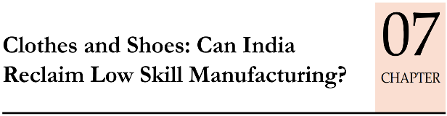

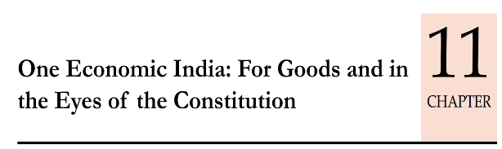
Economy: 6 pillars + theory + current + BES17 (pre cum Mains)
1.Banking, Fin, Insur.
6.HRD
2.Budget
3.BoP
4.Sectors
5.Infra
V1:c3,4
V1:c2,3, 6,9,11(GST),13
V1c:5
V1c:7(Textile),11(trade)
V1c:10
v1c:12, 14; Budget^Rail
11 pages bol-bachchan ► 12 slides
33 pages bol-bachchan ► 13 slides
And then GDP, IIP, CPI, WPI etc. “Indexes”
+ Demonetization impact on them.

Slide 2
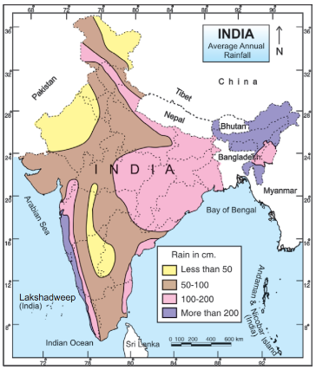
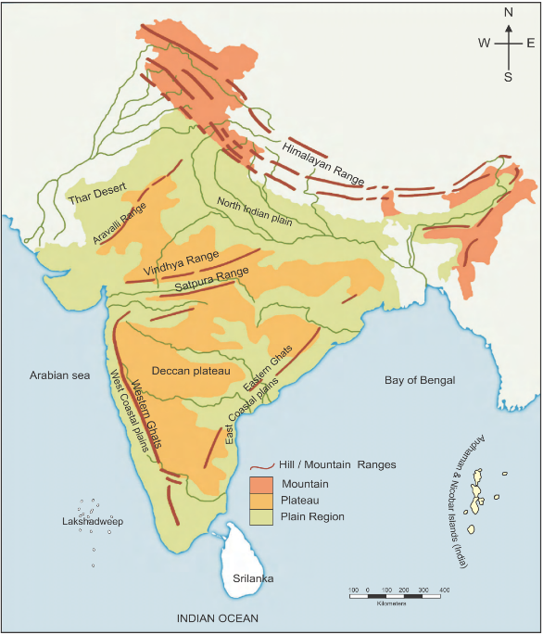

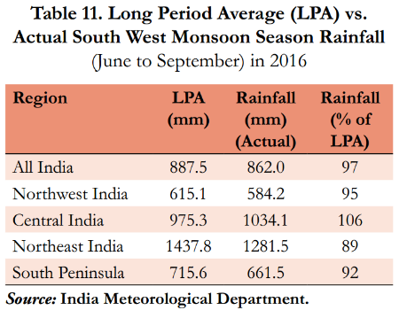
2014
2015
2016
Drought
Drought
2017
Normal
Normal
Under Ministry of Earth Sciences
4
1
2
3

Slide 3

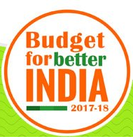
2x income by 2022
Demonetization: 60 days interest waiver for agri loans in PACS & Central Cooperatives.
CBS for above 2 cooperatives. Why? Already taught link.
NABARD: long term irrigation (20k cr); Micro irrigation Fund (5k cr), new Dairy infra fund (8k cr)
Agri loan: 10L cr “TARGET”; [PSB, NABARD refinance. Not from “govt’s pocket” itself else imagine Fiscal deficit!]
ISS: 15k cr. [subsidy from “govt’s pocket”] for crop loans upto Rs.3 lakh @7-3=4%. [100% central sector scheme]
Fertilizer subsidy: 70k cr. [Urea> NBS (PK)]

Slide 4
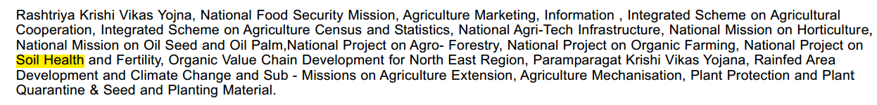
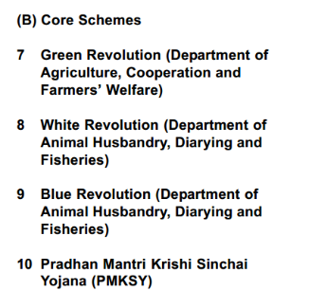
CSS: 28-6=22 Core Schemes: 60:40 (ordinary States) | 90:10 (Sp. Cat States)
Rashtriya Krishi Vikas
4% growth in Agri & allied sector
Krishonnati
5% in horti/veggies
National food security Mission
Sustainable Agro Mission
Increase cereal/pulse production & reduce imports
Agro forestry cover
Soil health card: more mini labs @KVK
Paramparagat Krisihi Vikas (ORGANIC FARMING)
E-NAM
“Amazon marketplace for agro”
Budget-2017: More Mandi tie-up
National Agriculture Market (NAM)
Pashu Sanjivani:
UID-Healthcard for milk animals
Model Contract Farming Law= farmer sell fruit, veggies to corporates without APMC Mandi middleman
Tie up Spot market with Derivative Market with E-NAM. <already taught link>

Slide 5
Mock Question for Prelims
Which of the following scheme(s) has/have primary and explicit objective of achieving 4% growth in agriculture and allied sector?
National Food security Mission
Rashtriya Krishi Vikas Yojana
Krishonnati Yojana
All of the above.

Slide 6

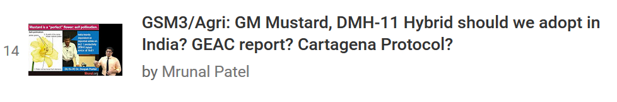
Agri theory and contemporary issues covered: playlist link
GM-Mustard from Environment playlist

Slide 7
Budget & Economic Survey “SEASONS”…
Agriculture
“carry forward”
BES17
BES16
“L”
1
2
3
4
5
6
7
8
1
2
3
4
5
6
1
2*
3
4
5
6
Mfg. sector, GDP, inflation. Revise & update before we “demonetize”

Slide 8
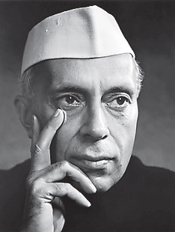
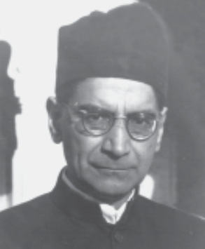
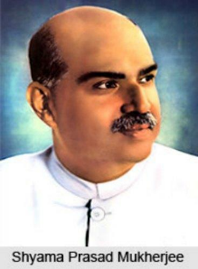
Industrial Policy
Shyama Prasad Mukerjee
1956
1948
State must control the “Commanding Heights” of Economy

Slide 9
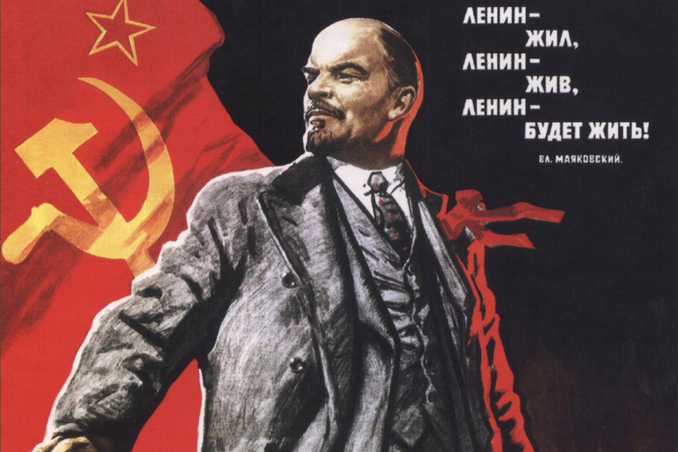
Lenin: “Commanding Heights of the Economy”
Steel
Coal
Electricity
Railways
“The State” must control these “commanding heights!
1956: Industrial Policy resolution (IPR)
1956-61: 2nd FYP, Mahalanobis Model

Slide 10

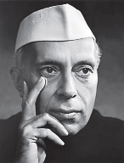

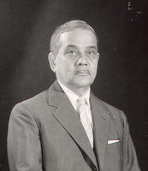



IPR’56: Industries 3 fold classification
1) Reserved for the “STATE” e.g. railway, atomic energy
2) Private sector to supplement “State”e.g drug, dye, plastic
3) Left for Pvt sector
LICENSE
Regional Equality
Quota
Produce more only if Govt convinced it’s beneficial
What about Rural Development? Better reserve some things for Village and Small Scale industries also!
e.g. Agarbatti, Aachar, Almari etc.
Dattatreya Gopal Karve Committee (1955)
Notes:
Later RBI dy. gov

Slide 11
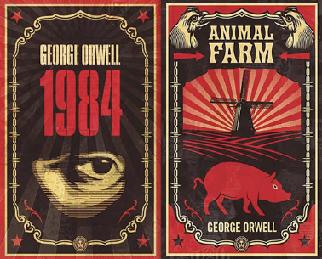
Economic system
Nehruvian India: Socialist system with Strong Public sector , but private sector also..
Economic Questions: 3
What to produce?
How Much?
For Whom?
Socialist
State
State
State
Capitalist
Market
Market
Market
If worker owns everything..
Reward based on “need”. Since each have same need..
Communism
Today, Most Governments are somewhere in between
“MIXED” Economy
i.e. Both State and Market decide
State owns everything. Reward based on deeds (work)
“Socialism”
More self study: NCERT Class11

Slide 12
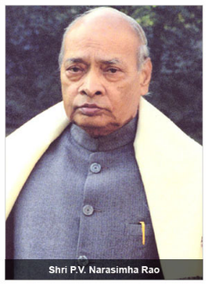

Industrial Policy
Shyama Prasad Mukerjee
1956
1948
State must control the “Commanding Heights” of Economy
1991
LPG
L-Q-I-Raj; BoP crisis

Slide 13
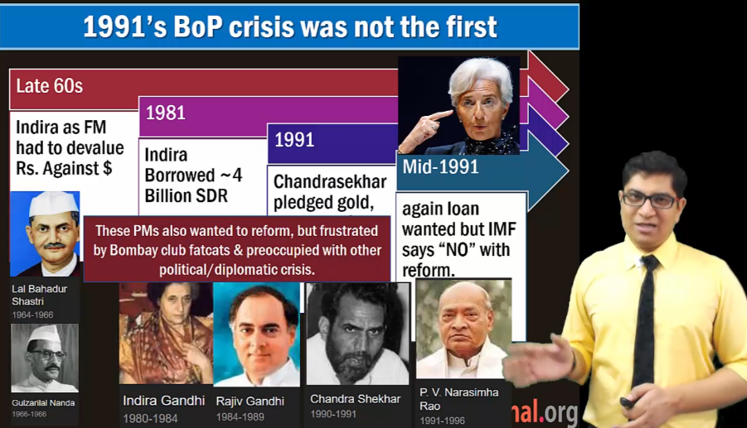
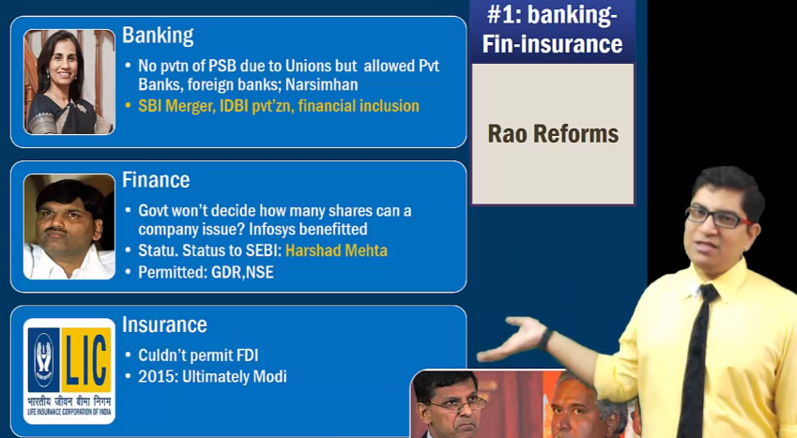
For Mains: Self study… ML16/GSM1-RAO link

Slide 14
Post-LPG: industrial Policy 1991 [FDI relax, Disinvestment..]
’14: pvt investment in rail infra., metro permitted.
Atomic Energy
Atomic Minerals
Rail Transport
PVT. KEEP OUT:
HCN: Hydrocyanic acid= Prussic acid. Dye, explosive, pesticides
Phosgene: plastic, pesticides
Carbon’s Isocyanates. E.g. Methyl Isocyanate (MIC) Union Carbide-fertilizers/pesticides (Sevin), Bhopal tragedy 3/12/84
Alcohol distillation Brewing
Tobacco Cigar
Electronic Aerospace & Defense
Industrial Explosive
Large industry in SSI products
Hazardous Chemical
License given by Secretarial of Industrial Assistance (SIA) under DIPP under Comm. Min.
If outside this venn diagram, then no need for license.
just file Industrial Entrepreneur’s Memorandum (IEM) @DIPP, From 2014: online 24 x 7 !!
Notes:
FDI relaxed
NRI can invest upto 100%
Software technology parks
Disinvestment of PSU, Miniratna-Navratna
MRTP act (‘69)=> CCI act (2002)

Slide 15
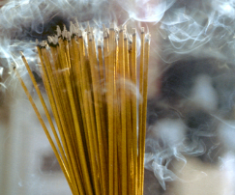


Investment >1 crore* (varies by item)
Pickles & chutneys Bread two edible oils (without solvent extraction) -Mustard oil, Ground nut oil Wooden furniture and fixtures Exercise books and registers Wax candles Laundry soap | Safety matches Fire works Agarbatties Glass bangles Steel almirah Rolling shutters Steel chairs, tables, furniture Padlocks utensils- stainless steel, aluminum
SSI
If large industry wants to mfg. SSI reserved items then must get license + 50% export [Doesn’t apply to SEZ]
Karve Committee
Notes:
'; At present, a small scale industrial unit is an undertaking in which investment in plant and machinery, does not exceed Rs.1crore, except in respect of certain specified items under hosiery, hand tools, drugs and pharmaceuticals, stationery items and sports goods, where this investment limit has been enhanced to Rs.5 crore. A comprehensive legislation which would enable the paradigm shift from small scale industry to small and medium enterprises is under consideration of Parliament. Pending enactment of the above legislation, current SSI/ tiny industries definition may continue. Units with investment in plant and machinery in excess of SSI limit and up to Rs. 10 crore may be treated as Medium Enterprises (ME).';

Slide 16
MSME Classification: investment
Cottage
only Family members hired
Handmade products
Village industry
Area: <10k population
Investment: <15k / worker
Capital investment is negligible
MSME Development Act 2006
[classification depends on investment in plant/machinery ]
MUDRA bank to help Micro Units.
Self study link
 | Mfg. Sector (32%) | Service (68%)
MICRO | upto 25 lakhs | upto 10 lakhs
SMALL | >25 lakhs upto 5 cr. | >10 lakh up 2 cr.
MED. | >5 cr. Upper limit 10 cr. | >2 cr. upper limit 5 cr.

Slide 17
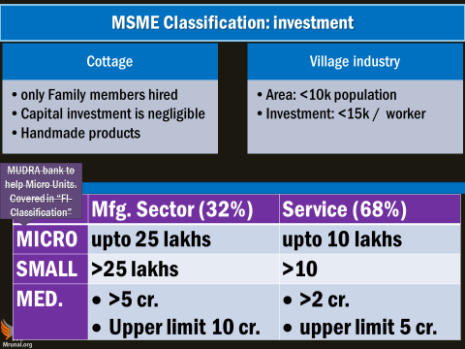
Benefits of being a in MSME / Cottage / Village industry?
Capital subsidy: for loan.
RBI PSL, SEDF / SIDBI <Taught>
MUDRA Bank: 2.44 lakh cr in budget’17 <Taught>
Standup India, Credit guarantee by Government <Taught >
AIM, SETU, ASPIRE <link>
PM employment generation program, Khadi board, Coir Board, Udhyami mitra Yojana etc.
☺ No taxation upto
No excise duty: 1.5 cr turnover/PA
No Service tax: <10 lakh /year
No GST: upto 20 lakh turnover (ordinary state), and upto 10 lakh turnover (sp. Cat. State)

Slide 18

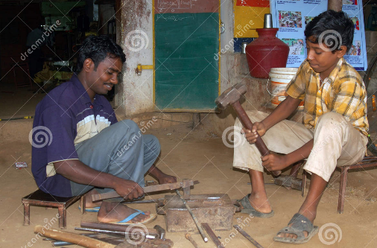
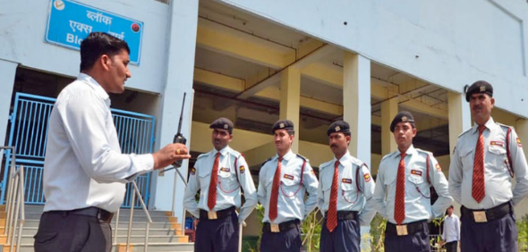
Unorganized Sector
Factories Act, 1948
Plantation acts, bidi-cigar act
PSUs, Cooperatives
Shops and Commercial Establishments Acts
Outside that
Organized Sector
But workers protected under Unorg. Workers S/S Act ’08.
Informal Job = No written contract with employer,
so not covered in traditional EPFO/ESIC etc. SS schemes

Slide 19
industries
Organized sector: registered company: upto Rs.50 cr turnover: 25% corporation tax on profit. <lecture>
Unorganized sector: <2 cr. Turnover Presumptive taxation on profit: higher benefit if cashless transaction. <Digital Payment lecture>
MAT credit upto 15 years (earlier 10 years)**
startups Profit linked deduction**
Budget 2017

Slide 20

Agriculture, MFG, Organized, unorganized sector learned, then
What is?
Undertakings / enterprises

Slide 21
Government owned = RTI applies to all
Government
cPSE
Government Companies
Public Corporations
Dept. Undertakings
Not Government “employees”: salary, service, conduct, discipline rules, election duty..
Post, Railway
Direct CAG audit
Government employees
CAG selected private auditors
Under companies act
Individual
Holding vs Subsidiary
SPV, Joint Venture
By act of parliament
Audit CAG himself
Notes:
Indian Railways, postal Department.
commercial activity such as engineering, manufacturing etc.
directly controlled, just like any other department
not under Companies act
Employees = Government servant. (service conduct rules apply)
Directly CAG + RTI

Slide 22
Holding vs subsidiary companies vs SPV
Guj. State Government
Government
Holding Co
Subsidiaries
Gujarat Urja Vikas Nigam Ltd. (GUVNL)
Uttar Gujarat Vij Co ltd.
Dakshin
Madhya
Paschim
GIFT ltd. (SPV): gift city
ILFS: Infrastructure Leasing & Financial Services Limited
Central India Bank
Guj.Urban Dvlp co. ltd
UTI, LIC
SBI, HDFC
If only two then Joint venture (JV)

Slide 23

What is SBI?
SBI Act 1955 (Corporation)
Banking ltd.
Life Insurance
SBI : 74%
General Insurance
26% Insurance Australia Group
SBI: 74%
5 “Subsidiaries”
26% BNP Paribas Cardif
If only two then Joint venture (JV)
If only two then Joint venture (JV)
Notes:
Presidency banks: Bengal, Bombay, Madras
Imperial Bank of India (1921)
SBI Act 1955- Government owned “Public” Corporation
SBI life insurance “COMPANY” ltd. JV between SBI + BNP Paribas
SBI General Insurance “COMPANY” ltd. JV between SBI +IAG (insurance Australia group
SBI Mutual funds “Private” limited Company

Slide 24

Ministry of Heavy Industries & PE-> Dept of public enterprises
4 schedules
Salary of executives
Ratna: depending on profitability
A,B,C,D: depending on investment, profit etc.
“Ratna Status”
Maharatna
Navratna
Miniratna-I
Miniratna-II
Advantages: autonomy- investment M&A etc.
Annual Public Enterprises survey
for parliament
MINUS PSB & Insurance Cos.

Slide 25
cPSE (most ‘companies act’)..SAIL, GAIL..
Disinvestment <REFER Fiscal Deficit>
Strengthen our CPSEs through consolidation, mergers and acquisitions
We propose to create an integrated public sector ‘oil major’ which will be able to match the performance of international and domestic private sector oil and gas companies.
Budget 2017
Notes:
By these methods, the CPSEs can be integrated across the value chain of an industry. It will give them capacity to bear higher risks, avail economies of scale, take higher investment decisions and create more value for the stakeholders. Possibilities of such restructuring are visible in the oil and gas sector

Slide 26

Mergers & consolidation in public sector enterprises
Dept of financial services
Min. of Comm-> Dept of Telecom
Min. Petro & Natural Gas
Civil Aviation
PSB
“17: SBI
Telecom
5 asso.
BMB
“86: MTNL (Delhi, Mumbai)
cOMC
“Oil Major”
2000: BSNL for rest of india
02: Pramod Mahajan proposed
“17: Budget
Aviation
Indian Airlines
“07: Air India
2017: talks, but ‘ no decision yet’

Slide 27
Mock Question for Prelims
Budget 2017 proposed merger of ___
Public sector oil and gas companies, to form an “oil major”
Copyright board with intellectual property appellate board
National Highway tribunal with Railway appellate tribunal
Answer Choices
a) Only 1 and 2 (b) Only 2 and 3
c) Only 1 and 3 (d) all of them
Hint: finance bill is money bill-walla PPT …see again!

Slide 28


Legal framework for industries
Factory Labor reforms
Companies Act DONE.
LINK

Slide 29
Labour reforms
Factory, Labor : concurrent list
44 union, 150+ state laws = Inspector-bribe raj, compliance cost, NOT EASE OF Doing Biz ☹
Budget 2017
Minimum Wages Act, 1948
Payment of Wages Act, 1936
Payment of Bonus Act, 1965
Equal Remuneration Act, 1976.
4 Codes
Industrial Relation
Social Security & Welfare
Safety, Working Condition
WAGES

Slide 30
Factories Act 1948-> Narendra Jadhav Committee (2010)->
criteria | 1948 Workers | 2014 bill (pending)
power used | 10 | 20
power not used | 20 | 40
Cooler, washroom, children operating heavy machinery?
Work hrs, weekly holiday?
Pending in Rajya Sabha

Slide 31

Factories Act amendment: 2014 bill
Women Empowerment
Amnesties for Workers
Self Certification
No arrest on minor issues
Cooler, spittoon, restroom etc depending on size.
Night shift, safety provisions, overtime..
Pending in Rajya Sabha
Notes:
Women workers can do nightshift
Safety provision and home transport
Can work on moving / heavy machinery
Exempt: PH and mothers
Cool water irrespective of #workers
Spitton, sitting facilities=> compoundable offense.
Restroom, lunchroom >75 workers
Canteen: 200> workers
Self certification, no arrest for minor offenses.
Union can also make rules. (earlier only states)
100 hours overtime per 3 months
Min. 90 days / year to get paid leaves.
Capacity: horsepower=> kilowatts
Can decide its own workweek.

Slide 32
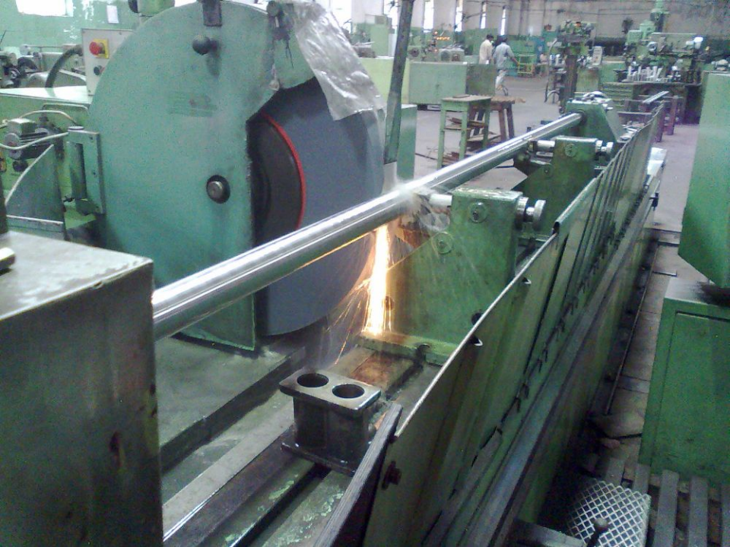
Factories Act 1948-> 2016 amendment (LS pass, RS Pending)
Both union and states can make rules
Quarterly overtime: 50 hrs-> 100 hrs
Even upto 115 hrs / quarter if high workload
Even upto 125 hrs / quarter if public interest e.g. steel production during war
Minimum Wages Act: overtime = ~2x the normal salary

Slide 33
Payment of Wages Act 1936 -> 2017 Amendment
Union | states empowered to notify industries where salary must not be given in cash.
Payment Method
Coin and currency
By default
Cheque / DBT
If worker gives written authorization
No longer necessary. Boss can pay salary in Cheque, DBT even without employee’s consent. = “less cash economy”.
Notes:
No illegal deduction, timely payment.

Slide 34
Mock Question for Prelims
What are the salient provisions of Payment of Wage (Amendment) Act 2017?
Factory owner can pay salary to workers only through cheque, bank transfer and other cashless modes only.
Factory owner must pay twice the normal rates for the overtime work.
Factory owner must provide equal remuneration to male and female work for equal amount of work.
Answer Choices
a) Only 1 and 2 (b) Only 2 and 3
c) Only 1 and 3 (d) None of them

Slide 35
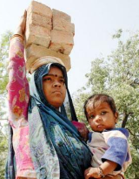
The Maternity Benefit Act 1961 -> 2017 Amendment under Labour ministry
Provision
BEFORE
AFTER
Paid leave
12 weeks
26 weeks [first two kids only]
Crèche [शिशु-गृह]
If 50/> employees; 4 visits day
Work from home
NA
Possible if both agree
Inform woman of such benefits
??
MUST
12 weeks for mothers via Adoption or surrogacy
In Government service rules, even father 15 days paid leave.
Here nothing.
All this is applicable only to factories, shops, mines etc. with 10/> workers. Unorganized sector not covered. [IG Matritva Sahyog 6k]

Slide 36
Model Shops and Establishment Bill 2016
Labour concurrent
Applies to shop with 10/> workers but not in “factory type mfg.”.
Can run shop 365 days x 24/7.
IT sector: more flexibility (for international time zones)
Women: Night shift with security, restroom, crèches and amnesties
Workers: paid leave, earnest leave etc.
Budget 2017: Asked states to adopt with local modification. = ▲Ease of doing biz.

Slide 37
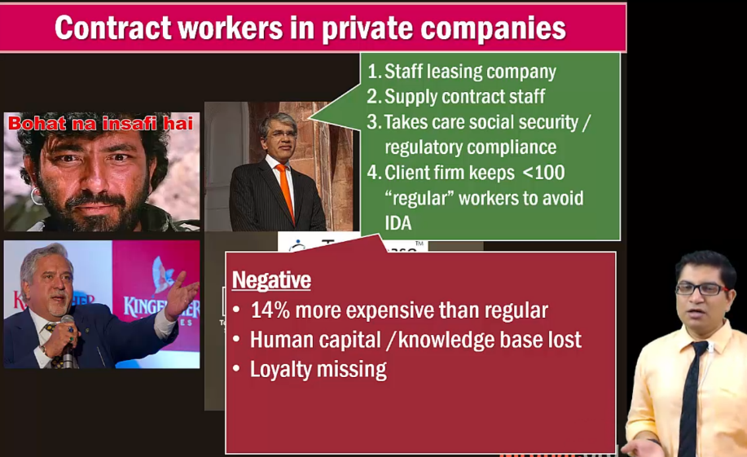
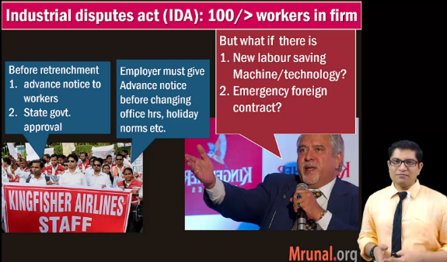
For Mains: GSM2, 3- Self study: labour reforms, EPFO’s regulatory cholesterol is preventing “formal jobs” BES164 Link

Slide 38
Economy: 6 pillars + theory + current + BES17 (pre cum Mains)
1.Banking, Fin, Insur.
6.HRD
2.Budget
3.BoP
4.Sectors
5.Infra
V1:c3,4
V1:c2,3, 6,9,11(GST),13
V1c:5
V1c:7(Textile),11(trade)
V1c:10
v1c:12, 14; Budget^Rail
Agri, mfg, labour laws done. Next :
~1 dozen Skill schemes + 1 Make in India
+ “Yearbook” type initiatives for “Innovation / IPR” .
11 pages bol-bachchan ► 12 slides
33 pages bol-bachchan ► 13 slides
And then GDP, IIP, CPI, WPI etc. “Indexes”
+ Demonetization impact on them.

